Slide 1
iOS-SDK
Sisoft Technologies Pvt Ltd
SRC E7, Shipra Riviera Bazar, Gyan Khand-3, Indirapuram, Ghaziabad
Website: www.sisoft.in Email:info@sisoft.in
Phone: +91-9999-283-283

Slide 2
About the iOS Technologies
iOS is the operating system that runs on iPad, iPhone, and iPod touch devices
The operating system manages the device hardware and provides the technologies required to implement native apps
The iOS Software Development Kit (SDK) contains the tools and interfaces needed to develop, install, run, and test native apps that appear on an iOS device’s Home screen

Slide 3
The iOS Architecture

Slide 4
The iOS Architecture

Slide 5
The iOS Architecture Is Layered
At the highest level, iOS acts as an intermediary between the underlying hardware and the apps you create
Apps do not talk to the underlying hardware directly
Instead, they communicate with the hardware through a set of well-defined system interfaces
These interfaces make it easy to write apps that work consistently on devices having different hardware capabilities

Slide 6
Cocoa Touch Layer
The Cocoa Touch layer contains key frameworks for building iOS apps
These frameworks define the appearance of your app
They also provide the basic app infrastructure and support for key technologies such as multitasking,touch-based input, push notifications, and many high-level system services

Slide 7
Cocoa Touch Layer…
High-Level Features
AirDrop
Multitasking
Auto Layout
Storyboards
Local Notifications And Apple Push Notification Service
Gesture Recognizers
Standard System View Controllers
…..

Slide 8
Cocoa Touch Layer…
Frameworks
Address Book UI Framework
Event Kit UI Framework
Game Kit Framework
iAd Framework
Map Kit Framework
Message UI Framework
Twitter Framework
UIKit Framework

Slide 9
Media Layer
The Media layer contains the graphics, audio, and video technologies you use to implement multimedia experiences in your apps
The technologies in this layer make it easy for you to build apps that look and sound great
Features
Graphics Technologies
Audio Technologies
Video Technologies
AirPlay

Slide 10
Media Layer…
Media Layer Frameworks
Assets Library Framework
AV Foundation Framework
Core Audio
Core Video Framework
Media Player Framework
OpenAL Framework
OpenGL ES Framework
Quartz Core Framework
Sprite Kit Framework
…

Slide 11
Core Services Layer
The Core Services layer contains fundamental system services for apps
Key among these services are the Core Foundation and Foundation frameworks, which define the basic types that all apps use
This layer also contains individual technologies to support features such as location, iCloud, social media, and networking

Slide 12
Core Services Layer..
Features
Peer-to-Peer Services
iCloud Storage
Automatic Reference Counting
Block Objects
Grand Central Dispatch
In-App Purchase
SQLite
XML Support
File-Sharing Support,Data Protection

Slide 13
Core Services Layer..
Frameworks
Foundation Framework
Accounts Framework
Address Book Framework
Ad Support Framework
CFNetwork Framework
Core Data Framework
Core Location Framework
Core Media Framework
Social Framework
….

Slide 14
Core OS Layer
The Core OS layer contains the low-level features that most other technologies are built upon
Even if you do not use these technologies directly in your apps, they are most likely being used by other frameworks
And in situations where you need to explicitly deal with security or communicating with an external hardware accessory, you do so using the frameworks in this layer

Slide 15
Core OS Layer…
Frameworks
Accelerate Framework
Core Bluetooth Framework
External Accessory Framework
Generic Security Services Framework
Security Framework
System
64-Bit Support

Slide 16
Important links
For more and detailed information on ios technologies visit link:
https://developer.apple.com/library/ios/documentation/miscellaneous/conceptual/iphoneostechoverview/Introduction/Introduction.html
For iOS version history visit link:
http://en.wikipedia.org/wiki/IOS_version_history

Slide 17
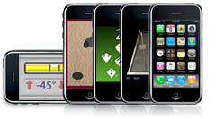
What is the iOS SDK?
SDK stands for Software Development Kit
Development program for anyone to develop programs for iPhone and iPod Touch
Development Resources
Testing on iPhone,iPad
Distribution on the App Store

Slide 18
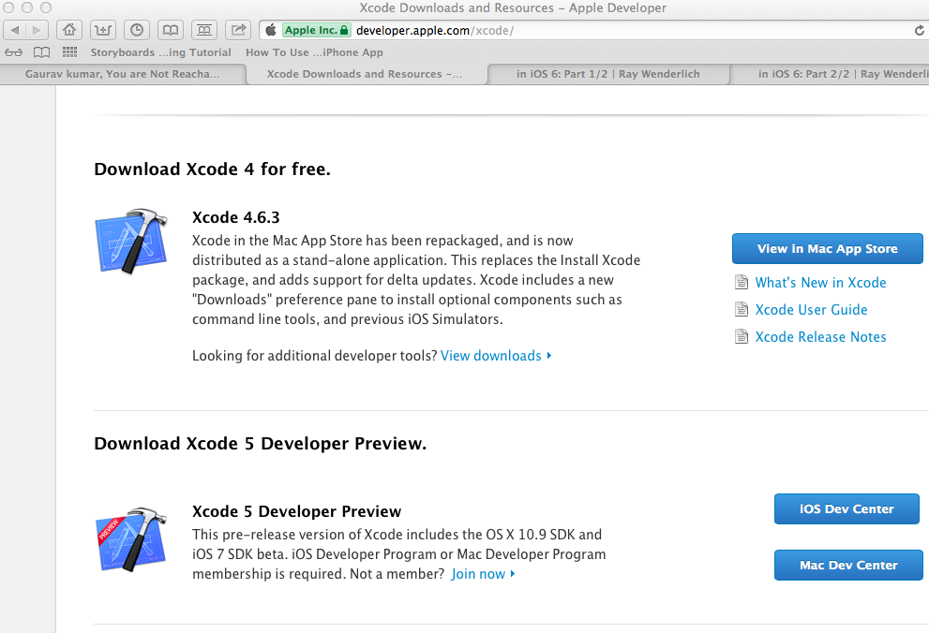
Installing SDK

Slide 19
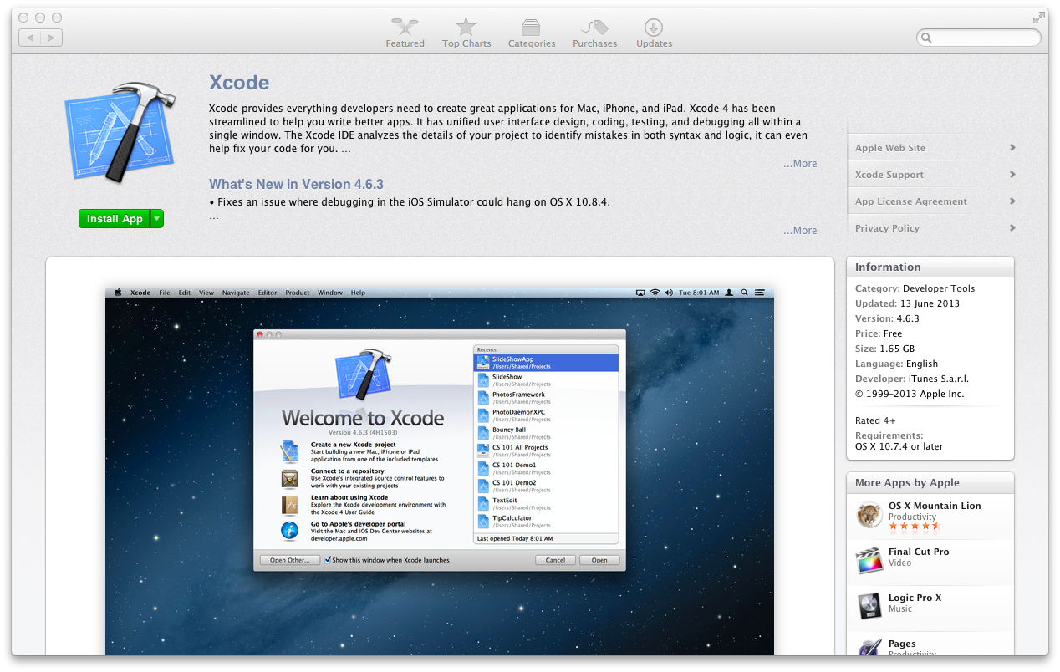

Slide 21
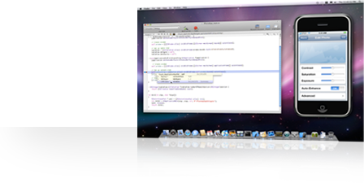
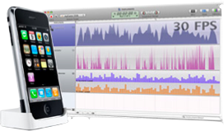
SDK Overview
Develop on your Mac
Test on Your iPhone
Distribute on App Store

Slide 22
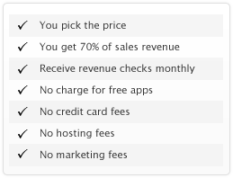
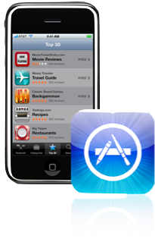
App Distribution
Distribution on App Store provides revenue for developers who are making programs for iPhone and iPod Touch
App Store is wireless or through the cell network where customers can download material

Slide 23
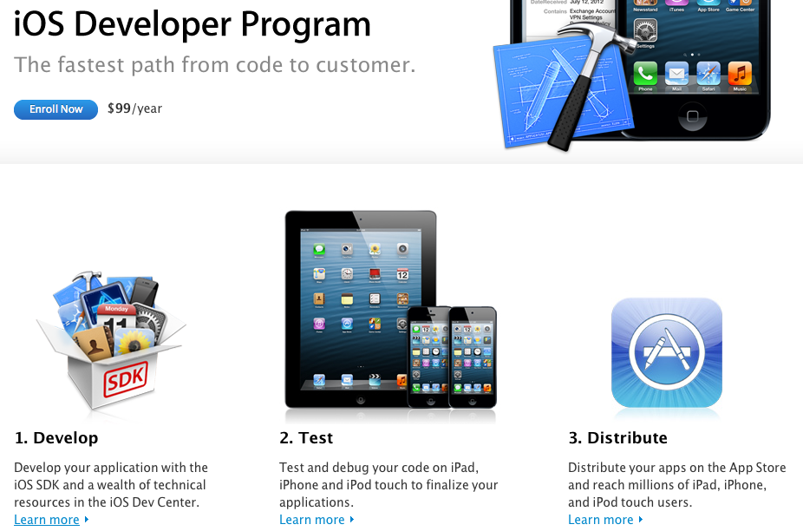

Slide 24
The-Foundation-Framework
Sisoft Technologies Pvt Ltd
SRC E7, Shipra Riviera Bazar, Gyan Khand-3, Indirapuram, Ghaziabad
Website: www.sisoft.in Email:info@sisoft.in
Phone: +91-9999-283-283

Slide 25
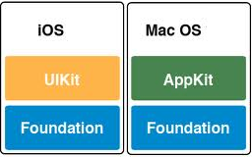
Fondation framework
Founfation framework is commomn to both iOS and Mac OS

Slide 26
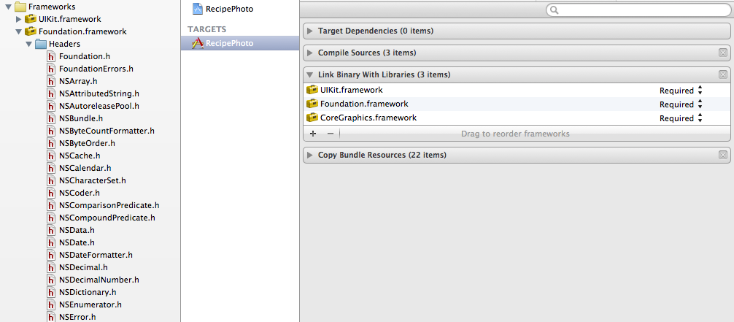

Slide 27
Introduction
The Foundation framework defines a base layer of Objective-C classes In addition to providing a set of useful primitive object classes, it introduces several paradigms that define functionality not covered by the Objective-C language. The Foundation framework is designed with these goals in mind:
Provide a small set of basic utility classes
Make software development easier by introducing consistent conventions for things such as deallocation
Support Unicode strings, object persistence, and object distribution
Provides a level of OS independence, to enhance portability

Slide 28
Cocoa Objective-C Hierarchy for Foundation

Slide 29
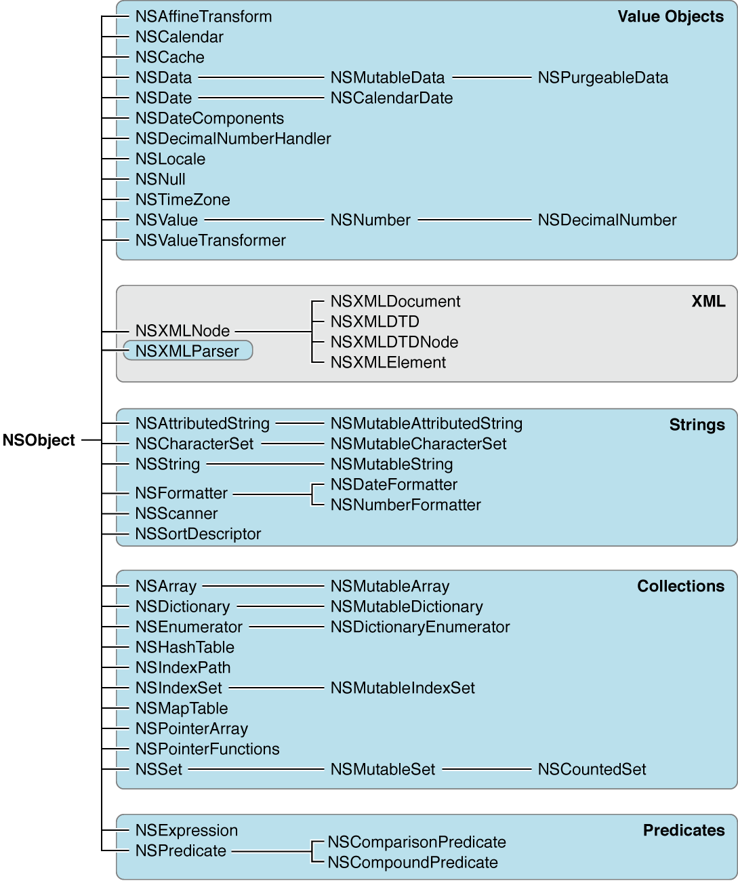

Slide 30
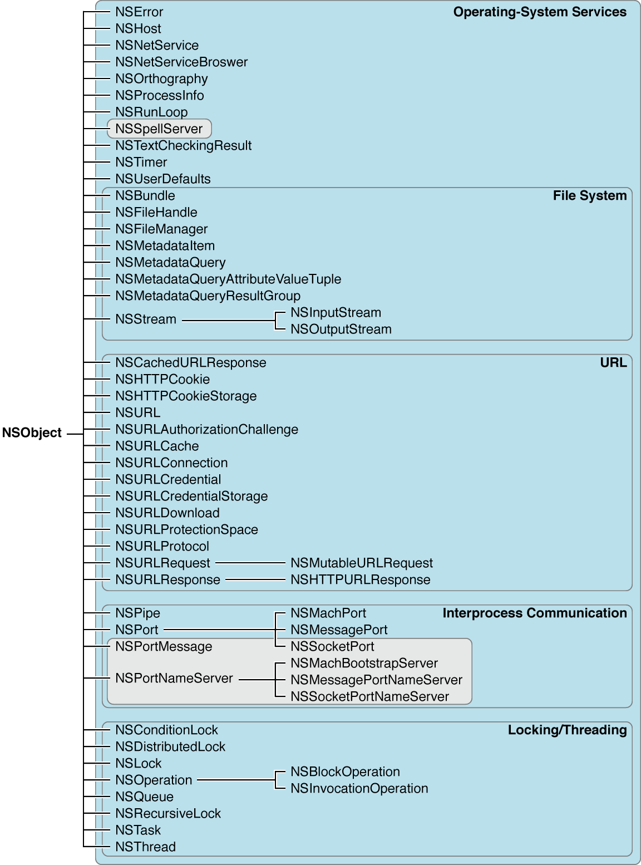

Slide 31
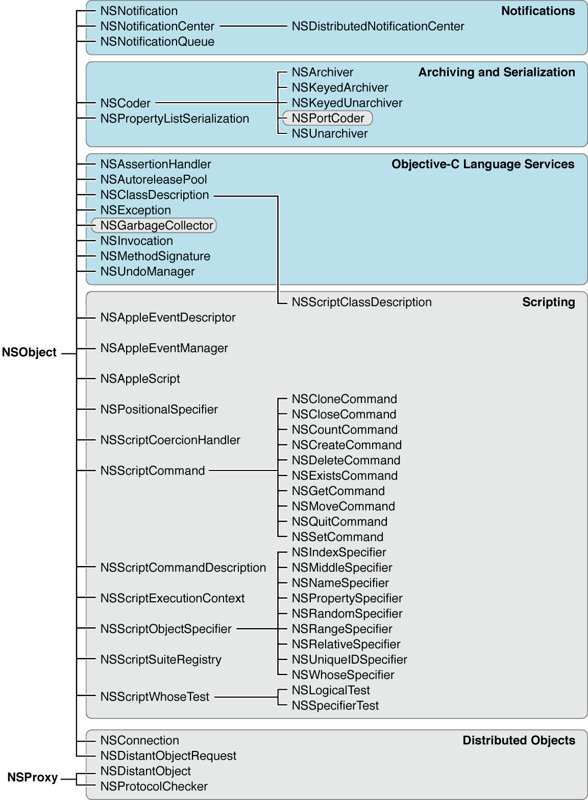

Slide 32
Many of these classes have closely related functionality
Data storage
NSData and NSString provide object-oriented storage for arrays of bytes
NSValue and NSNumber provide object-oriented storage for arrays of simple C data values
NSArray, NSDictionary, and NSSet provide storage for Objective-C objects of any class.

Slide 33
Related functionalities..
Dates and times:
The NSDate, NSTimeZone, and NSCalendar classes store times and dates and represent calendrical information. They offer methods for calculating date and time differences
Together with NSLocale, they provide methods for displaying dates and times in many formats, and for adjusting times and dates based on location in the world

Slide 34
Related functionalities…
Text and strings:
NSCharacterSet represents various groupings of characters that are used by the NSString and NSScanner classes
The NSString classes represent text strings and provide methods for searching, combining, and comparing strings
An NSScanner object is used to scan numbers and words from an NSString object

Slide 35
Related functionalites..
Application coordination and timing
NSNotification, NSNotificationCenter, and NSNotificationQueue provide systems that an object can use to notify all interested observers of changes that occur. You can use an NSTimer object to send a message to another object at specific intervalsObject creation and disposal:
Object creation and disposal:
NSAutoreleasePool is used to implement the delayed-release feature of the Foundation framework

